Slide 1

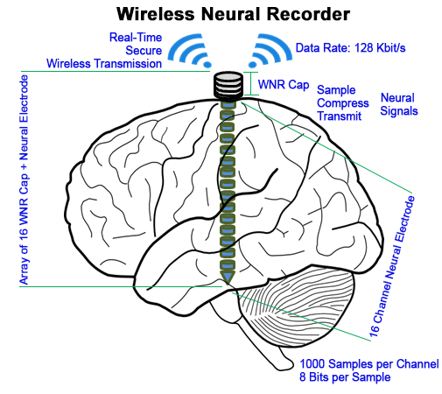
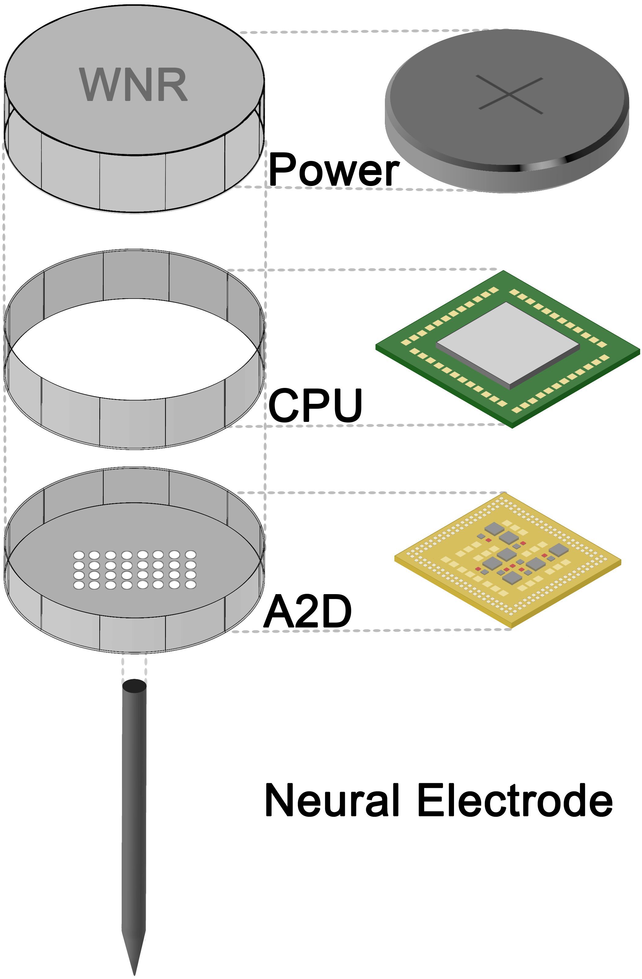
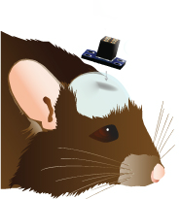
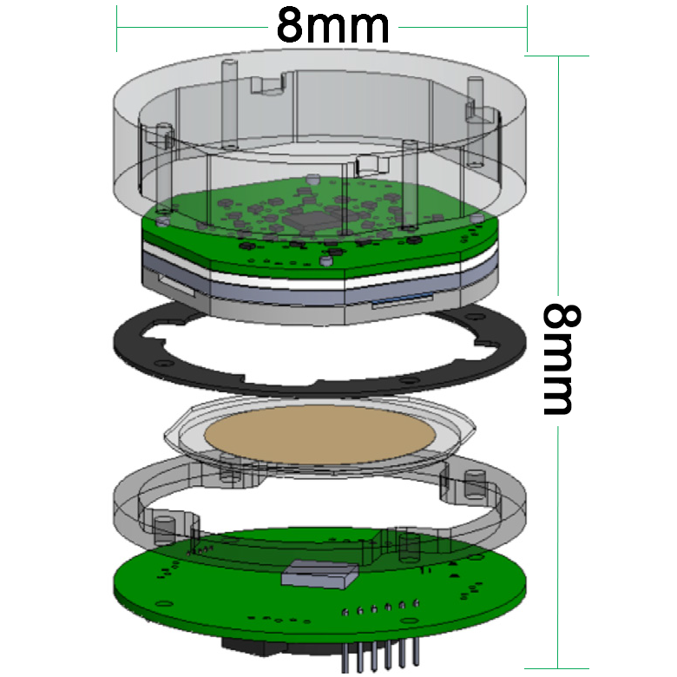
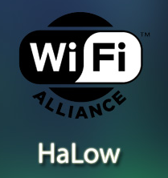

Energy-Efficient High-Throughput Wireless Transmission of Multi-Channel Neural Signals
Yuan Gao, Xin Huang, Tingkai Liu, Stephen Xia
Department of Electrical and Computer Engineering, Rice University
WNR Project Description
Engineering Design for a Single WNR Cap
Problem:
Current Electrocochleography (ECoG) monitoring requires physical cables connected to brain to collect critical data for epilepsy diagnosis
Lack of advanced wireless implantable devices hinder scientific progress and affect patient quality of life
System Design Goal:
Create a Compact, Power-Efficient, High-Fidelity add-on cap to ECoG electrodes to wirelessly transmit neural data securely in real-time
Areas of Impact:
Neurosurgeons & Hospitals – Simpler procedure and data monitoring
Scientists & Research Institutions – Brain Machine Interface R&D
Epilepsy Patients & their Families – Mobility and QOL improvement
Neural Data
A2D Converter
ARM Microprocessor
Bluetooth Low Energy
Recording Server
WNR System Design Specifications
16 Channels of Data
1K Samples/s
8 Bits of Data
Total: 128 Kbit/s
Intan RHD2132
Specialized Neural Recording with Protective Circuitry
NanoVolt Precision
Nordic NRF52
Powerful ARM Cortex-M4 Processor
Data Buffering and Compression
Nordic NRF52
128 bit AES encryption
1 Mbit/s Bandwidth
< 6mA power consumption
Controls & communicates with all WNR units
Real-time Neural Data Collection and Presentation
WNR System
Results
Data:
Available 32 Channel Sampling
1000 Samples per Second
8 Bit Data Precision
Compute Power:
50% Data Compression
Available Compute Power for New Functionality
Safety:
<2°C Temperature Change
Integrated Surge Protection with High Quality Components
Transmission:
Available 1 Mbit/s Bandwidth
Available 0.27 Mbit/s Throughput
Power:
Ultra-Low Power Consumption
12 Hour Battery Life
75mAh Off-the-Shelf Battery
Size:
PCB Size of 12x14 mm
Will meet 15x15x15 Size
Next Steps
WNR Add-on Cap Specifications
Criteria | Target Value
Data Channels | 16 Channels
Data Precision | 8 Bits
Sampling Frequency | 1000 Samples per Second
Form Factor | 15 x 15 x 15 mm
Battery Life | 12 Hours
Small animal testing and data collection with functional prototype
Fabrication of custom components for smaller
8 x 8 x 8 mm design
Utilize new WiFi HaLow for increased data rate and higher data fidelity
Modify WNR device to diagnose and monitor other diseases of the brain
Acknowledgements
We would like to thank Rice ECE department members: Dr. Gary Woods, Dr. Aydin Babakhani, Hamed Rahmani and UTHealth Neurosurgeon: Dr. Nitin Tandon, for their technical advice and project support.
Special thanks to the Brenner Foundation with Ellen Kirk and the resources of the Oshman Engineering Design Kitchen. Without them, this project would not be possible.

